Slide 1

Malignant Comment Classification Project
Submitted By:
Aswini A. Patil

Slide 2
Introduction
In the past few years, the cases related to social media hatred have increased exponentially. Social media is turning into a venomous pit for people.
The proliferation of social media enables people to express their opinions online but, at the same time, this has resulted in the emergence of conflict and making online environments uninviting for users.
The increase in cyber bullying cases can affect anyone mentally leading to depression, mental illness, self-hatred and suicidal thoughts.
Our goal here is to build a classification model using NLP techniques to classify comments as good/neutral or negative comments.

Slide 3
INTRODUCTION
The proliferation of social media enables people to express their opinions widely online.
Social media platforms are the most prominent grounds for such expressions.
However, at the same time, this has resulted in the emergence of conflict and hate, making online environments uninviting for users.
Goal is to build a prototype of online hate and abuse comment classifier which can be used to classify hate and offensive comments so that it can be controlled and restricted from spreading hatred and cyberbullying.

Slide 4
OBJECTIVE
Internet comments are bastions of hatred and vitriol. While online anonymity has provided a new outlet for aggression and hate speech, machine learning can be used to fight it.
The problem we sought to solve was the tagging of internet comments that are aggressive towards other users. This means that insults to third parties such as celebrities will be tagged as unoffensive, but “u are an idiot” is clearly offensive.
Objective is to build a prototype of online hate and abuse comment classifier which can be used to classify hate and offensive comments so that it can be controlled and restricted from spreading hatred and cyberbullying.

Slide 5

DATA EXTRACTION
1. train.csv: This contain the dataset on which will be working upon
2. test.csv: I have to predict the output for this data through the best model

Slide 6
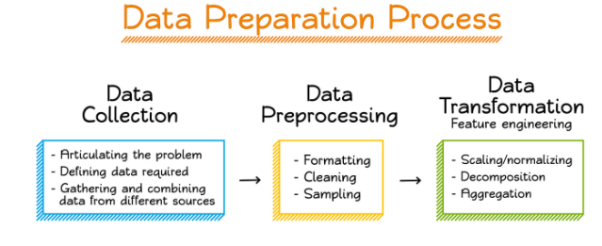
PREPROCESSING OF THE DATA
I have performed the following preprocessing on the data:
Removed punctuations
Removed the stop words
Stemming and lemmatization
Applied counter vectorizer

Slide 7

DATA MODELLING
I have used the Multinomial Naïve Bayes classifier for classification.
As it is suitable for classification with discrete features.
The algorithm estimates the conditional probability of a particular word given a class.
The variation takes into account the number of occurrences

Slide 8
DATA MODELLING
I have trained 5 different models:
Logistic Regression,
Random Forest,
Decision Tree Classifier
AdaBoost Classifier.
I have started modifying model parameters, perform feature engineering and balancing data strategies to improve the performance of the models.
Tried with more trees in the Random Forest model, include new variables, penalize wrong predictions from the minority class until I beat the performance of my current best model.

Slide 9
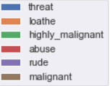
ANALYSIS OF RESULTS
Upon testing the models, on the malignant data I have analyzed the following:
The highest percentage of comments is in below order
Malignant
Rude
Abuse
Highly Malignant
Loathe
Threat

Slide 10
Prediction using test data:
First we will perform all the pre-processing steps performed on train dataset and use vectorizer to convert comments to vectors.
Predict the values using selected model and save it to a csv file.

Slide 11

FUTURE SCOPE
Predicted which age group is showing toxic behaviour to a particular group or person .
Add feature to automatically sensitize words which are classified as malignant.
Automatically send alerts to the concerned authority if threats are classified as severe.
Handle mistakes and short forms of words to get better accuracy of the result.

Slide 12
Conclusions
KEY FINDINGS AND CONCLUSIONS OF THE STUDY
We have first loaded both test and train dataset and looked into it to check for null values, data types, dropping unnecessary columns.
Exploratory Data Analysis is performed using visualizations to gain insights. We observe more of comments classified as malignant comments.
We have used NLP to pre-process and clean data. Since we had 6 labels to be predicted we introduced a new column ‘label’ which shows ‘1’ for good/neutral comments and ‘0’ for negative comments.
We have used Vectorizer to convert comment tokens to numeric form.
After considering the mentioned algorithms we concluded Decision Tree Model to be best model which gave an accuracy of 95.2%.
We further used the model selected to predict ‘label’ for test dataset and saved it in csv file.

Slide 13
Conclusions
LEARNING OUTCOMES OF THE STUDY IN RESPECT OF DATA SCIENCE
After the completion of this project, we got an insight of how to preprocess the data and analyzing the data using Natural Language Processing techniques. We have used various NLP techniques to clean our data like Lemmatization, POS tagging, etc.
We were also able to learn to convert strings into vectors through vectorizer.

Slide 14
LIMITATIONS OF THIS WORK AND SCOPE FOR FUTURE WORK
Since the data keeps changing we cannot fully rely on this project in the distant future we need to update it with updation in data.
Due to lack of high computational power it took a lot of time to predict scores for each algorithm.
The Dataset here is imbalanced which may have caused a problem in scores obtained.
This project is done with limited resources and can be made more efficient in future.

Slide 15
Thank you

